Slide 1
BÁO CÁO KẾT QUẢ THỰC TẬP CHUYÊN NGÀNH
Trường Đại học Nha Trang
1-2023
Công ty TNHH Phần mềm và Tư vấn Kim Tự Tháp
Sinh viên thực tập: NGUYỄN THÀNH ĐẠT
GVHD: NGUYỄN ĐÌNH HOÀNG SƠN
CÁN BỘ HDTT: TRƯƠNG PHỤNG TIÊN

Slide 2
NỘI DUNG
01
02
KIẾN THỨC & LÝ THUYẾT
THỰC HÀNH BACK-END
03
04
THỰC HÀNH FRONT-END
KẾT QUẢ ĐẠT ĐƯỢC
1-2023

Slide 3
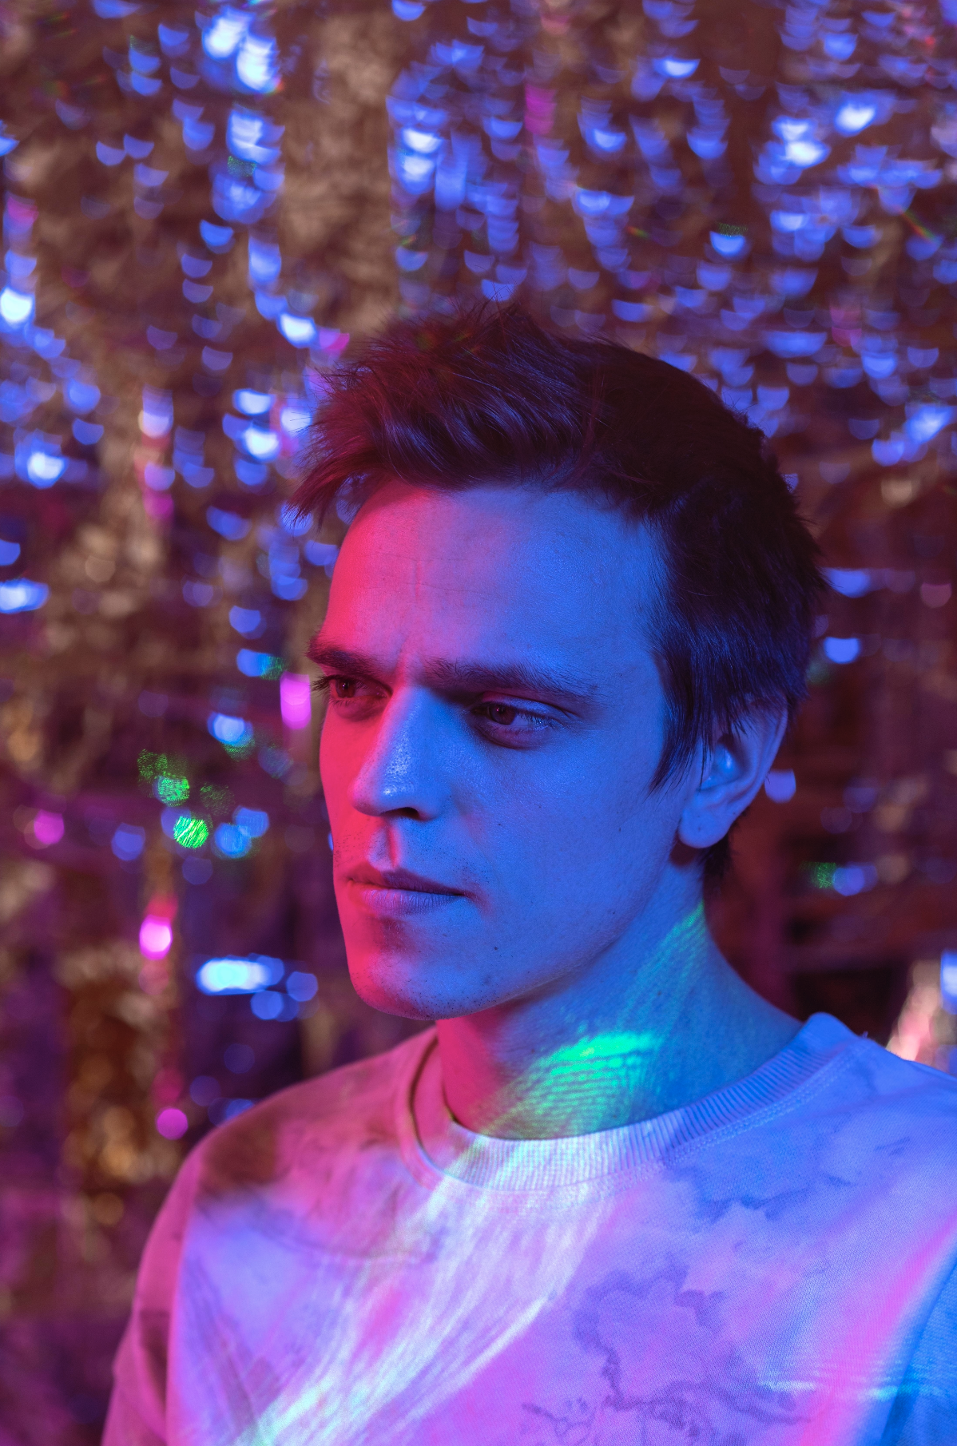
01
Kiến thức & Lý thuyết
1 - 2023

Slide 4
Kiến thức & Lý thuyết
Project
Ôn tập JavaScipt
Tìm hiểu cơ bản TypeScipt
Tìm hiểu ReactJS
Tìm hiểu về Web API – Net5, tìm hiểu Entity Framework Core

Slide 5
KIẾN THỨC & LÝ THUYẾT
 | Kiến thức & Lý thuyết đã học
JavaScipt | Ôn tập kiến thức đã học: toán tử,biến, hàm, cấu trúc, object | F2 - Insert your own text | F3 - Insert your own text | F4 - Insert your own text
TypeScipt | Tiếp thu kiến thức TypeScipt mới từ kiến thức JavaScipt đã học. | C2 - Insert your own text | C3 - Insert your own text | C4 - Insert your own text
ReactJS | Kiến thức cơ bản | JSX, State, Prop, Component | Dựng web đơn giản | Tạo dự án (Bài tập được giao)
Web API-net5 & Entity Framework | Kiến thức cơ bản | Get, Post, Push, Delete | Dựng web đơn giản | Tạo dự án (Bài tập được giao)

Slide 6

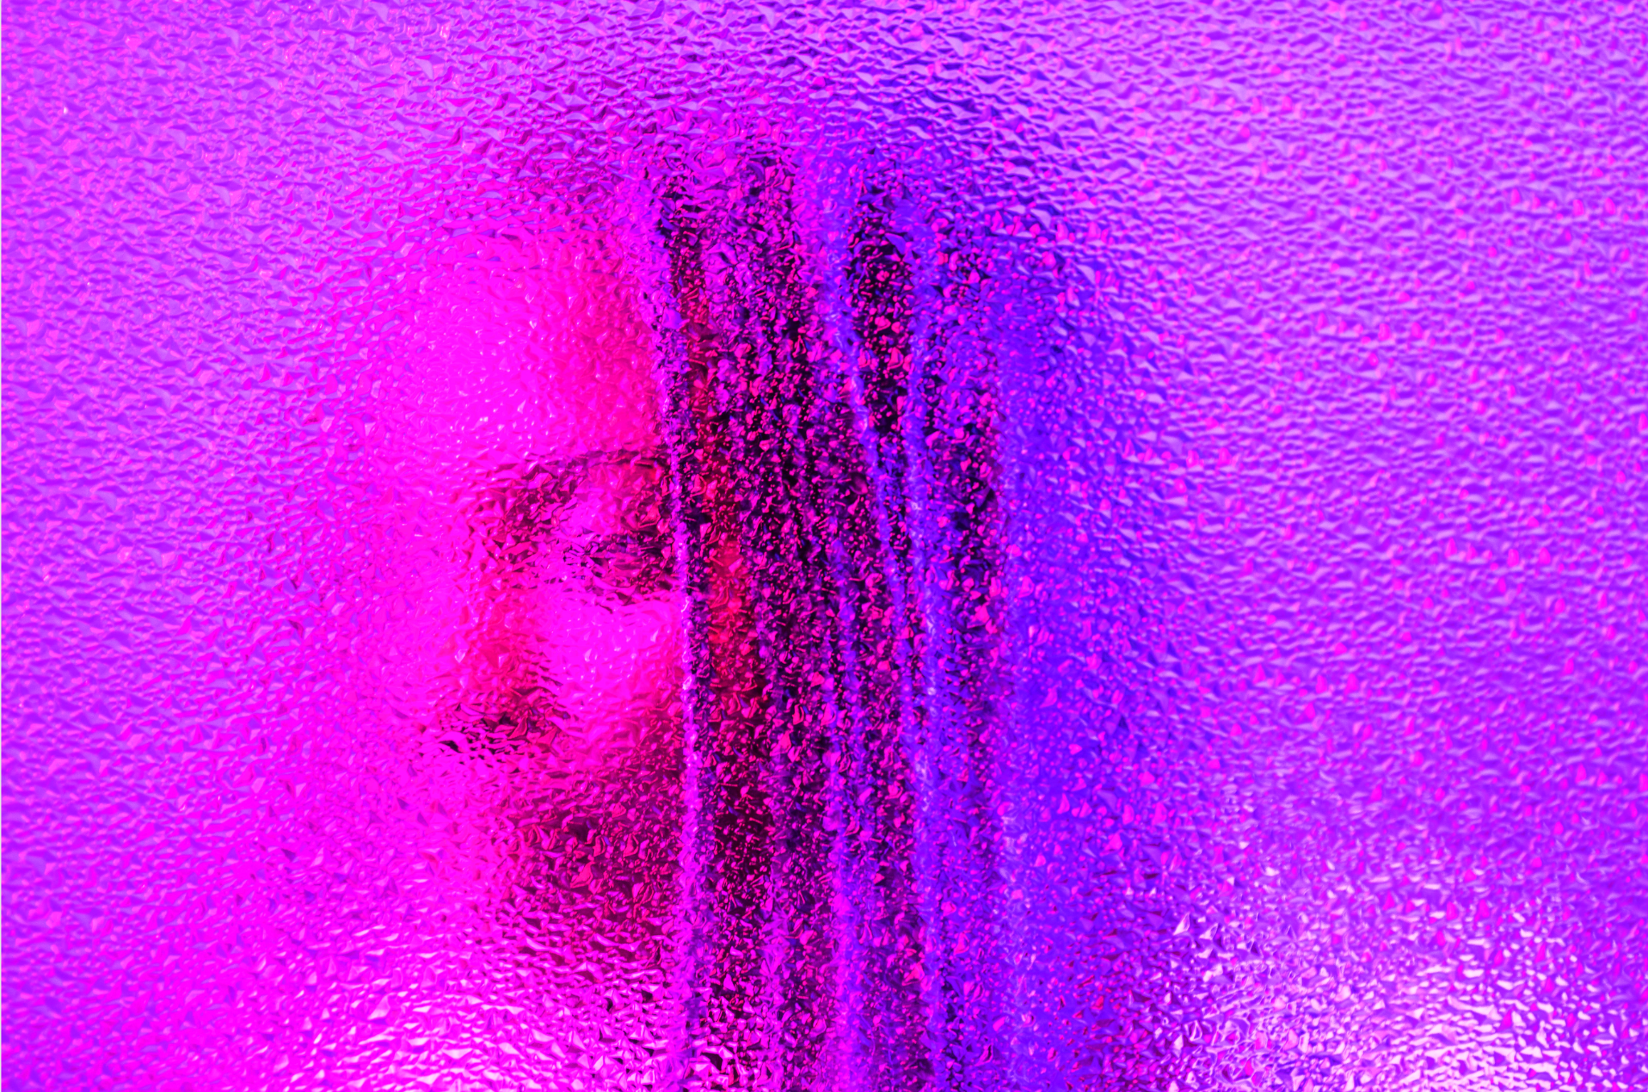

Công cụ hỗ trợ quá trình
Visual Code Studio
Visual Studio 2019
Ứng dụng duyệt web
Strategies
Despite being red, Mars is a cold place, not hot. It’s full of iron oxide dust
Jupiter is a gas giant and the biggest planet in the Solar System
Mercury is the closest planet to the Sun and the smallest one

Slide 7
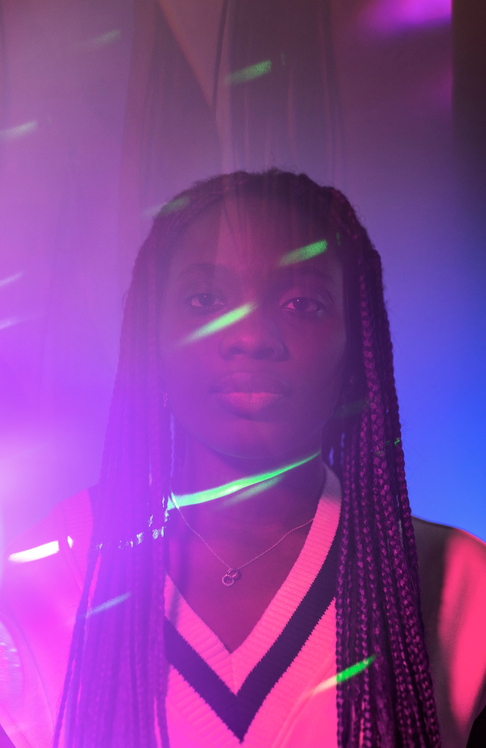
02
Thực hành Back-end
1 - 2023

Slide 8
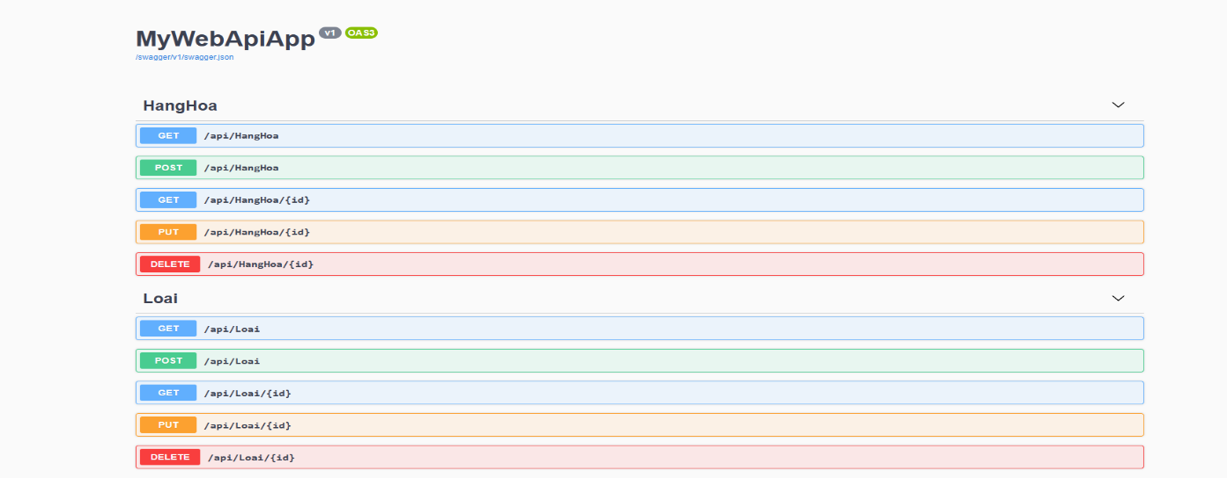
Dựng web đơn giản bằng Web API-NET 5
Trang web cho phép thực hiện 4 chức năng:
Risks
Get: Đọc dữ liệu
Post: Ghi dữ liệu
Put: Sửa dữ liệu
Delete: Xóa dữ liệu

Slide 9
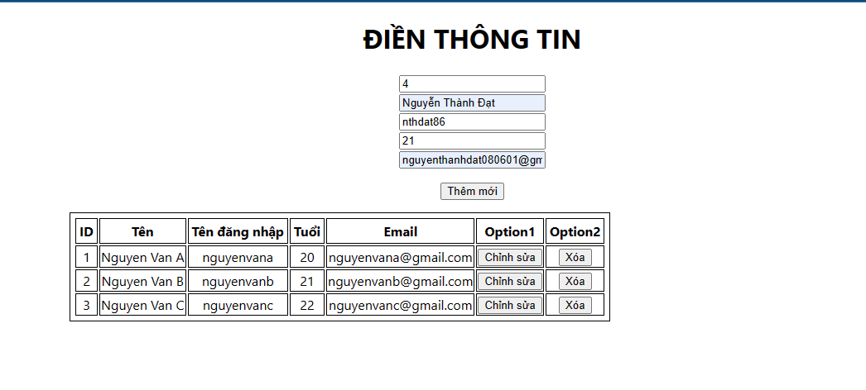
— Xây dựng web cho phép thêm, xóa, sửa thông tin người dùng
Technology
"

Slide 10
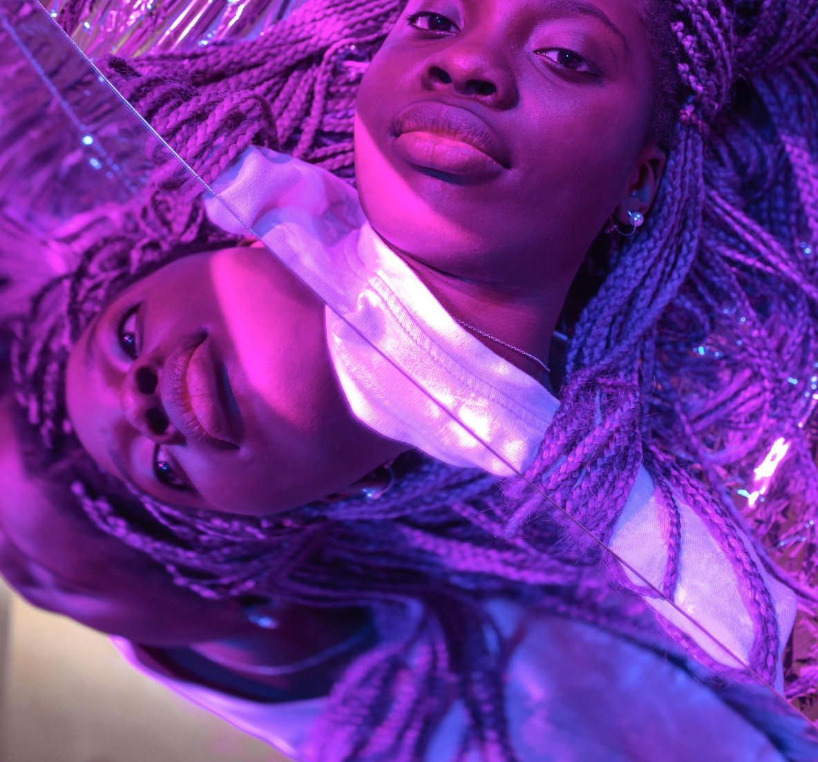
03
Thực hành Front-end
Management

Slide 11
Decisions: new market, new product, new company
Desirability
Profitability
Feasibility
Sweet spot
What will be the profitability of this strategic initiative?
What is the potential demand for our product in this new market?
What is the feasibility to enter this new market to the world?

Slide 12
Key drivers of the profit
 | Description | Example
The situation | You need to provide a neutral description with facts that you know your audience will agree on | Our company has been selling its products in the US for 10 years, with an annual profit growth above 10%
The complication | The complication is a desired change of the current situation | With a market share already above 40%, profit growth will be limited in the US
The question | The question that implicitly results from the complication | Should we enter the European Market or not?

Slide 13
Strategic planning project plan
Steps | Week | 1 | 2 | 3 | 4 | 5 | 6 | 7 | 8 | 9 | 10 | 11 | 12
1. Kick-off
2. Insights
3. Mission & vision
4. Key objectives |  | Workshop #1
5. Strategy map
6. Scorecard
7. Objectives |  |  |  |  |  | Workshop #2
8. First report

Slide 14
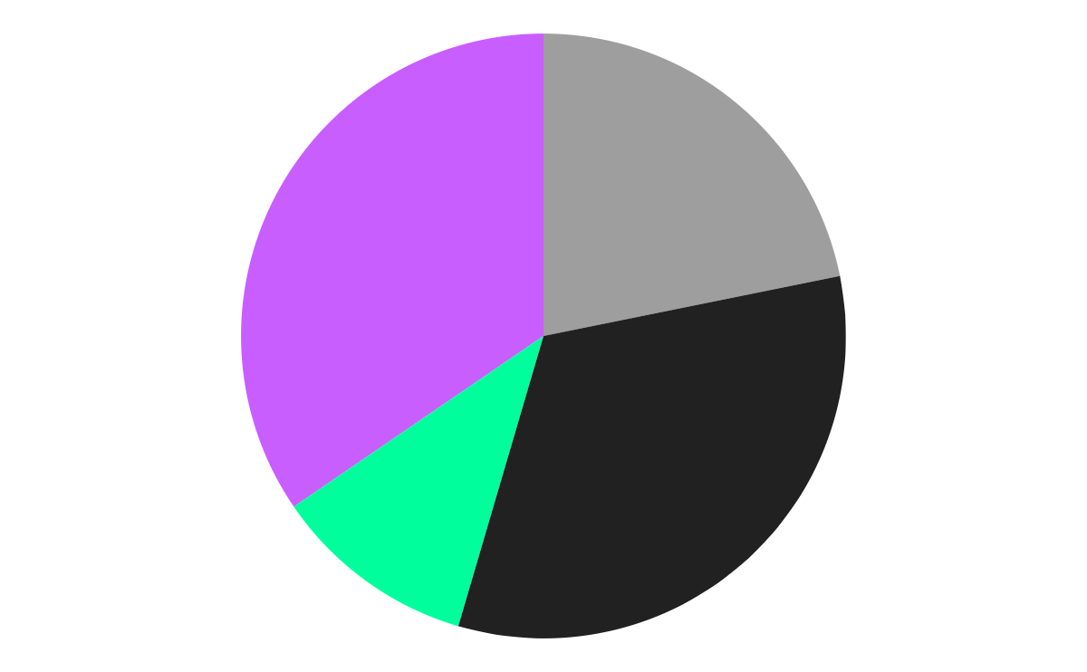
Impact of the risks
34.5%
21.8%
Venus
Jupiter
10.9%
32.7%
Neptune
Saturn
Risks
Venus has a beautiful name, but it’s hot
It’s a gas giant and the biggest planet
It’s the farthest planet from the Sun
It’s a gas giant and has several rings
Follow the link in the graph to modify its data and then paste the new one here. For more info, click here

Slide 15
Strategic perspectives
Strategies
Jupiter
Mars
Jupiter is the biggest planet in the Solar System
Mars is a cold place. It’s full of iron oxide dust
Mercury
Venus
Mercury is the smallest planet in the Solar System
Venus has a beautiful name but it’s terribly hot

Slide 16
Awesome words!
2022

Slide 17
Strong business plan
P
T
E
L
PESTLE
S
E
2022
Political
Technological
Replace the text with your own text
Replace the text with your own text
Economical
Legal
Replace the text with your own text
Replace the text with your own text
Social
Environmental
Replace the text with your own text
Replace the text with your own text

Slide 18
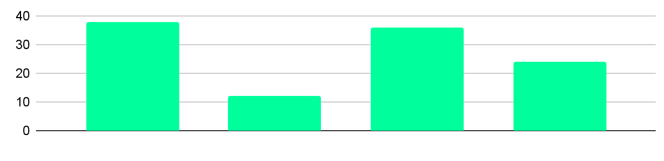
Strong business case
Project costs
Tangible benefits
NET present value
$4M
$14M
$8M
Cash flow (US $ million)
Change impact
Sponsor
Resources
Manager
Low
Medium
High
Insert your own text here
Replace the text with your own text
Insert your own text here

Slide 19
Financial model
Financial
Inc model | 2016 | 2017 | 2018 | 2019 | 2020 | 2021 | 2022
Assets
Cash | 2.1 | 1.2 | 0.4 | 0.1 | 0.5
Accounts | 0.1 | 1.5 | 3.6 | 4.9 | 6.4 | 16.3
Inventory | 1.0 | 1.0 | 1.0 | 2.0 | 2.0
Current asset | 0.1 | 1.8 | 4.6 | 6.9 | 9.9 | 23.1
Property | 0.1 | 1.5 | 3.6 | 4.9 | 6.4 | 16.3
Goodwill | 1 | 2 | 3 | 4 | 5
Total | 9% | 5% | 2%

Slide 20

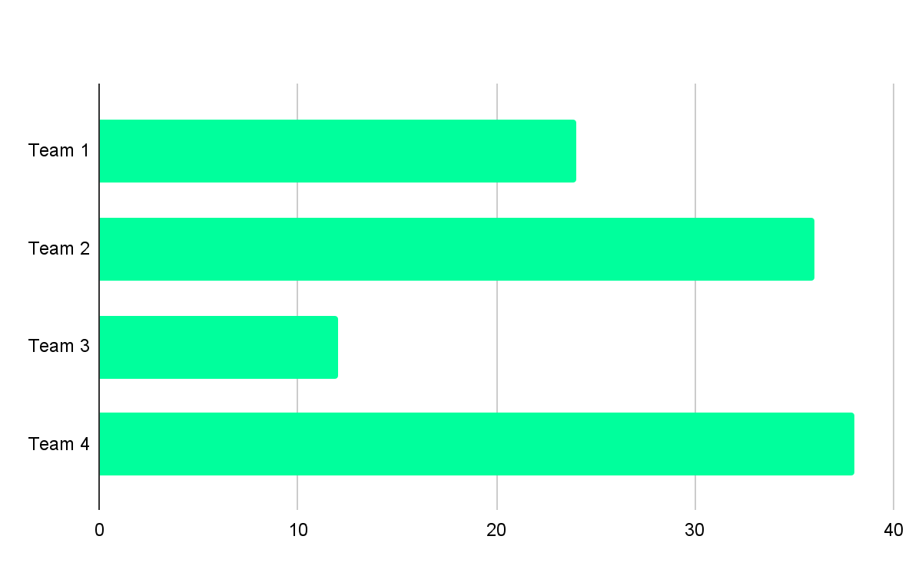
Financial model
Venus
60%
40%
Venus
Mars
Financial
Venus has a beautiful name and it’s hot
Despite being red, Mars is actually cold
Follow the link in the graph to modify its data and then paste the new one here. For more info, click here

Slide 21
Financial model
 | Basic | Standard | Advanced | Leading
Level | 1 | 2 | 3 | 4
Accounts | 20% | 70% | 10% | <1%
Description | - Insert your description here - Insert your description here - Insert your description here | - Insert your description here - Insert your description here - Insert your description here | - Insert your description here - Insert your description here - Insert your description here | - Insert your description here - Insert your description here - Insert your description here

Slide 22
Consulting proposal
Services
Fees
Expenses
Mercury is the closest planet to the Sun
Venus is the second planet from the Sun
Despite being red, Mars is actually a cold place
Invoices
Materials
Terms
Earth is the third planet from the Sun
Jupiter is the biggest planet of them all
Saturn is a gas giant and has several rings

Slide 23

A picture is worth a thousand words
2022

Slide 24

A picture always reinforces the concept
2022
Images reveal large amounts of data, so remember: use an image instead of a long text. Your audience will totally appreciate it

Slide 25
Answers and supporting arguments
How can the company reduce its costs by 10%?
Reduce costs by $5 million through operational improvements
Outsource non-core
Simplify core function
Review supplier cost
Evaluate cost and service
Design current processes
Select and review current
supplier costs
Select non-core functions
Compare current process to
best-in-class benchmarks
Evaluate cost of potential
alternative suppliers
Choose one partner for
each function
Adopt best practices based
on benchmarks
Negotiate supplier
contracts/choose options

Slide 26
Initiative prioritization matrix: Impact & effort
The initiative prioritization matrix will help you prioritize all your potential initiatives based on the following 2 criteria:
Impact
Effort
Despite being red, Mars is a cold place, not hot
Jupiter is the biggest planet in the Solar System
Saturn is a gas giant and has several rings
Neptune is the farthest planet from the Sun

Slide 27
Prioritization matrix
 | Initiative | Impact | Effort
1 | List all your potential initiatives |  | Very high
2 | List all your potential initiatives |  | Low
3 | List all your potential initiatives |  | High
4 | List all your potential initiatives |  | Very high
5 | List all your potential initiatives |  | High
6 | List all your potential initiatives |  | Low

Slide 28

Ansoff growth matrix
Do you know what helps you make your point clear? Lists like this one:
They’re simple
You can organize your ideas clearly
You’ll never forget to buy milk!
And the most important thing: the audience will never miss the point of your presentation

Slide 29
Business case
Management
1 | Venus is the second planet from the Sun
Business name
Company logo
xx/xx/xx
4 | Despite being red, Mars is actually a cold place
2 | Mercury is the closest planet to Sun
5 | Jupiter is a gas giant and the biggest planet
3 | Earth is the third planet from the Sun
6 | Saturn is a gas giant and has several rings

Slide 30
Competitor comparison table
Attributes | Competitor A | Competitor B | My business
Price | $360 | $320 | $320
Quality | Low | Medium | High
Customer age | 20-40 | 18-45 | 18-50
Reputation | Bad | Average | Very high
Location | Spain | Italy | US

Slide 31

Target
2022
Hobbies
Mars
It’s actually very cold
40%
Hobby 1
70%
Hobby 2
50%
Venus
It has a very nice name
60%
Hobby 3
40%
Earth
Name
Age
Occupation
It’s where we all live
20%
Peter Wilson
Xx years
Musician

Slide 32
Implement, track & manage status
Manage progress
Progress |  |  | Status | Link
Venus | 60% |  |  | www.yourlinkhere.com
Mars | 40% |  |  | www.yourlinkhere.com
Neptune | 80% |  |  | www.yourlinkhere.com
Jupiter | 30% |  |  | www.yourlinkhere.com
Earth | 90% |  |  | www.yourlinkhere.com
Ceres | 50% |  |  | www.yourlinkhere.com

Slide 33
Change management strategy plan
Extreme | Name of the change | Name of the change | Name of the change
High |  |  | Name of the change | Name of the change | Name of the change
Medium |  |  |  | Name of the change
Moderate
Low
Complexity of the change
Size of the change

Slide 34

04
Implementing changes
2022
You can enter a subtitle here if you need it

Slide 35
Sales and strategy plan
2022
1
2
3
Implementation
Internal analysis
External analysis
5
4
Sales plan
Sales strategy

Slide 36
956,790
Budgets
Big numbers catch your audience’s attention

Slide 37
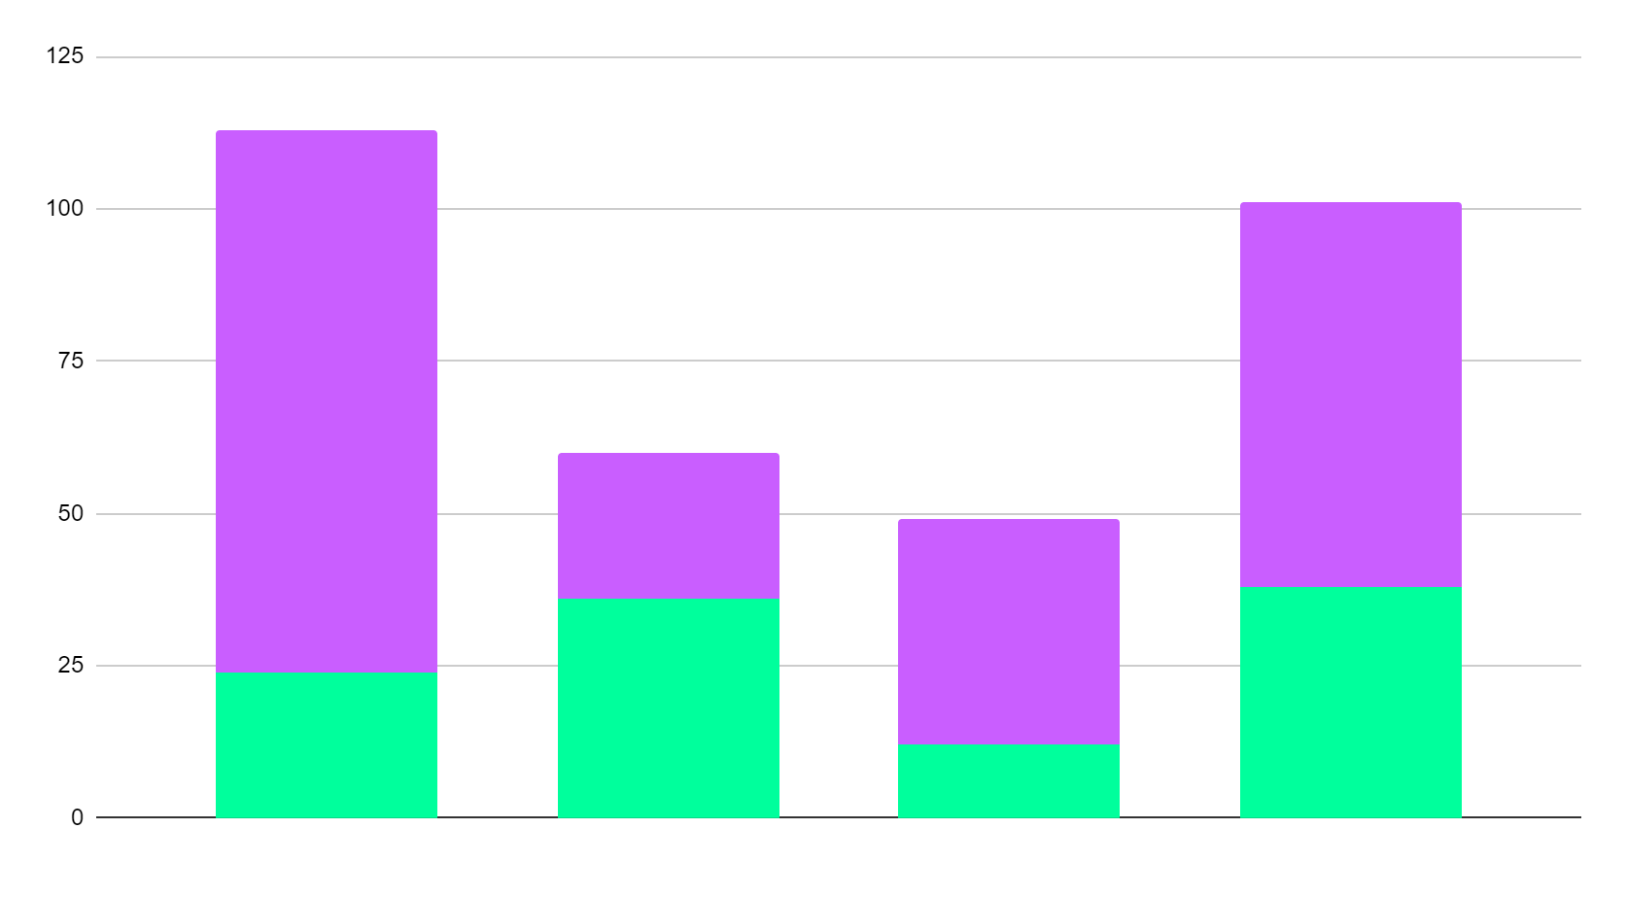
About the terms of the agreement
Venus
Mars
Team 1
Team 2
Team 3
Team 4
Venus has a beautiful name and it’s hot
Despite being red, Mars is actually cold
Follow the link in the graph to modify its data and then paste the new one here. For more info, click here

Slide 38
Future budgets
$2,348
$537
$7,834
$4,679
Budgets
Ratio and TV advertisement
Social media
Renting materials
Raises

Slide 39
Management approach
Management
Mars is red and a cold place
Mercury is the smallest planet
January
February
March
April
Venus has a beautiful name
Saturn is a gas giant with rings

Slide 40
Strategic alliances
Venus
Saturn
Neptune
Alliances
Venus has a beautiful name, but it’s hot
It’s a gas giant and has several rings
It’s the farthest planet from the Sun

Slide 41
Answers and arguments
Answers
Write your question
Write your answer
Mercury
Mercury is the closest planet to the Sun and the smallest one in the entire Solar System
Venus
It has a beautiful name and is the second planet from the Sun. It’s terribly hot, even hotter than Mercury
Earth
It’s the third planet from the Sun and also the only planet that harbors life in the Solar System

Slide 42
Waterfall management plan
Requirements
January
Design
February
Implementation
March
Verification
April
Maintenance
May

Slide 43
Maturity model
30%
70%
50%
2022
Basic
Standard
Advanced
Jupiter is the biggest planet in the Solar System
Saturn is a gas giant and has several rings
Neptune is the farthest planet from the Sun

Slide 44
Profitability ratios
2022
Worst peer
Best peer
Return on sales (%)
xx%
xx%
xx%
Return on equity (%)
xx%
xx%
xx%
Return on assets (%)
xx%
xx%
xx%
Return on capital (%)
xx%
xx%
xx%
Return on funds (%)
xx%
xx%
xx%
Company 1
Company 2
Company 3

Slide 45
Ten questions of business plan
1
What is your current situation?
6
Who are the key players?
2
What is your vision?
7
How do you make difference?
3
How do you reach your vision?
8
What is your marketing plan?
4
What do you offer?
9
What are your economics?
5
How big is the market?
10
What is the requirement to start?

Slide 46


Our team
Chris Pierce
Peter Witt
2022
You can replace the image on the screen with your own
You can replace the image on the screen with your own

Slide 47
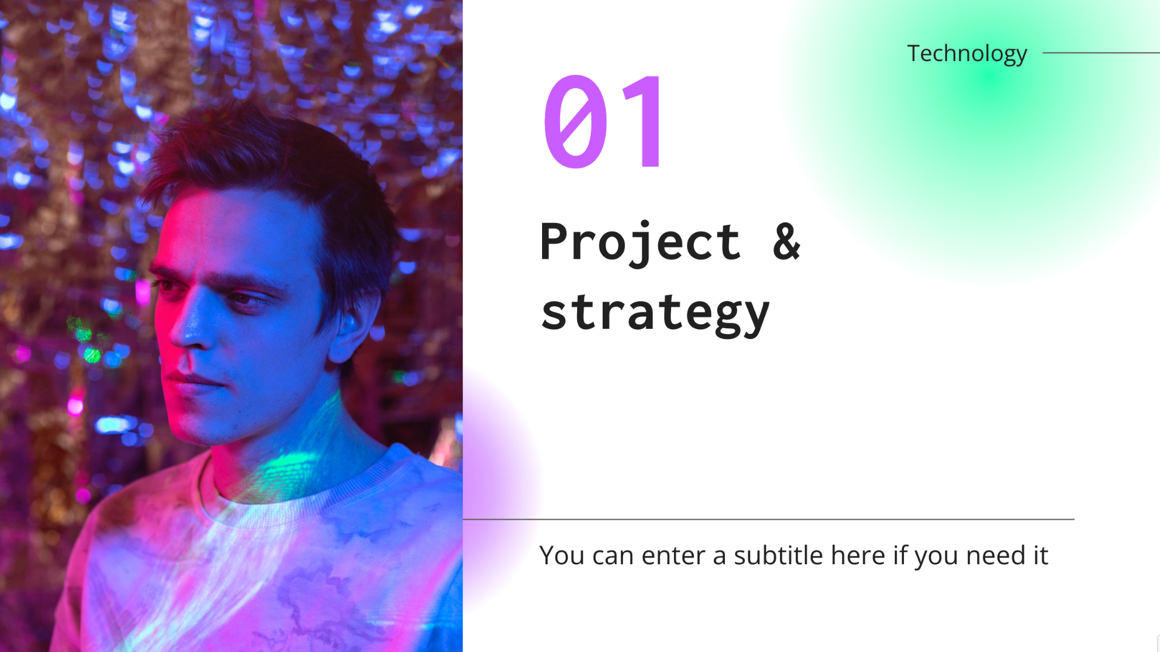
Desktop
You can replace the image on the screen with your own work. Just right-click on it and select “Replace image”

Slide 48
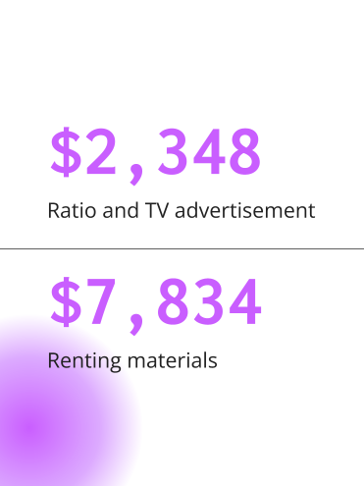
Tablet
You can replace the image on the screen with your own work. Just right-click on it and select “Replace image”

Slide 49
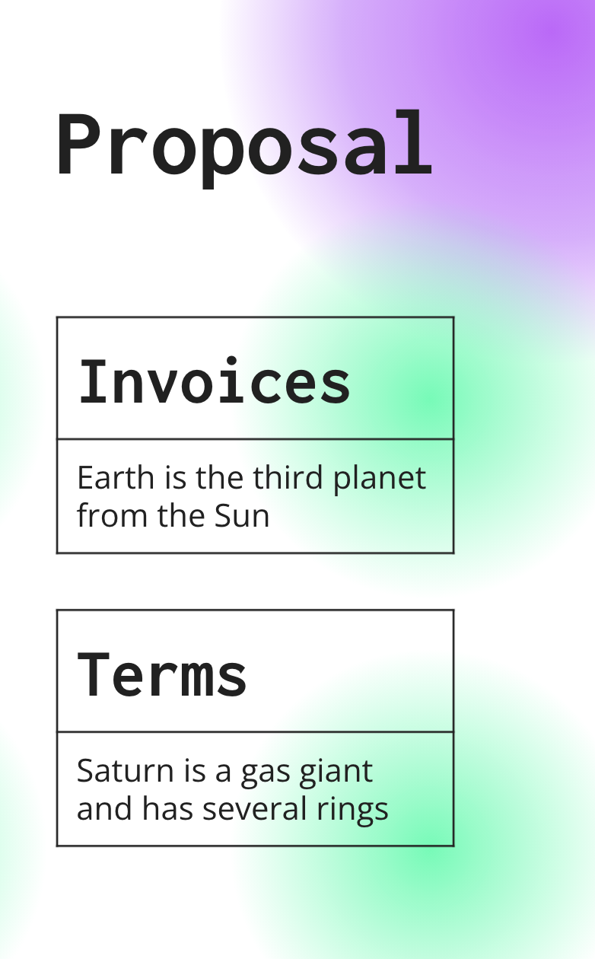
Smartphone
You can replace the image on the screen with your own work. Just right-click on it and select “Replace image”

Slide 50
Thanks!
Do you have any questions?
youremail@freepik.com
+91 620 421 838
yourcompany.com
Please keep this slide for attribution

Slide 51
Alternative resources
Here’s an assortment of alternative resources whose style fits the one of this template:
Photos:
Abstract vaporwave portrait of woman
Abstract vaporwave portrait of man I
Abstract vaporwave portrait of man II
Abstract vaporwave portrait of man III
Abstract vaporwave portrait of man and woman
Abstract vaporwave portrait of man IV
Abstract portrait of african american woman in vaporwave
Abstract portrait of african american woman in vaporwave style
Interior portrait of man and woman in vaporwave style
Abstract portrait of african american woman in vaporwave
Interior portrait of man and woman in vaporwave style I
Interior portrait of man and woman in vaporwave style II

Slide 52
Resources
Did you like the resources on this template? Get them for free at our other websites:
Photos
Abstract vaporwave portrait of woman I
Abstract vaporwave portrait of woman II
Abstract vaporwave portrait of woman III
Portrait of handsome man in vaporwave style
Interior portrait of handsome man in vaporwave style
Abstract portrait of woman in vaporwave style
Abstract portrait of african american woman in vaporwave style I
Abstract portrait of african american woman in vaporwave style II
Abstract portrait of man in vaporwave style I
Abstract portrait of man in vaporwave style II
Interior portrait of woman in vaporwave style
Interior portrait of man and woman in vaporwave style
Abstract vaporwave portrait of man
Abstract vaporwave portrait of woman
Abstract vaporwave portrait of man and woman

